Slide 1
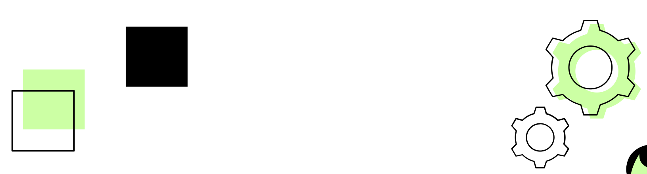

06 / 07 / 2026
Concurrent Voice-Command ML Pipeline
Fayez Slika – 6706
Jad Bou Nassif – 6337
Karim Bashnak - 6613

Slide 2
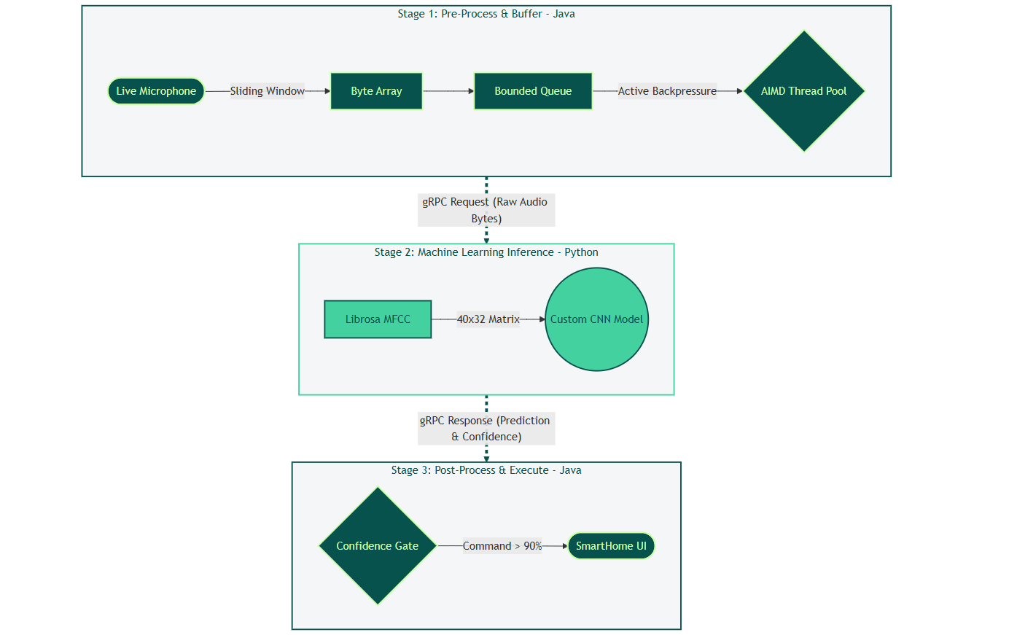
Stage 1: Java Pre-processing with sliding-window audio buffering.
Stage 2: High-performance gRPC communication layer (Port 50051).
Stage 3: Python-based CNN inference for real-time classification.
Load Balancing: Active AIMD Control for dynamic concurrency scaling.
01
System Architecture

Slide 3






Custom ML Pipeline
Raw Audio Slicing
MFCC Extraction
CNN Inference
Confidence Gate
Slices sliding-window byte array into exact 1.0-second chunks
Uses Librosa to mathematically map audio into a 40x32 cepstral coefficients matrix.
Custom architecture trained from scratch on 19,000 files.
Strict >90% threshold to drop background noise and prevent false positives.

Slide 4
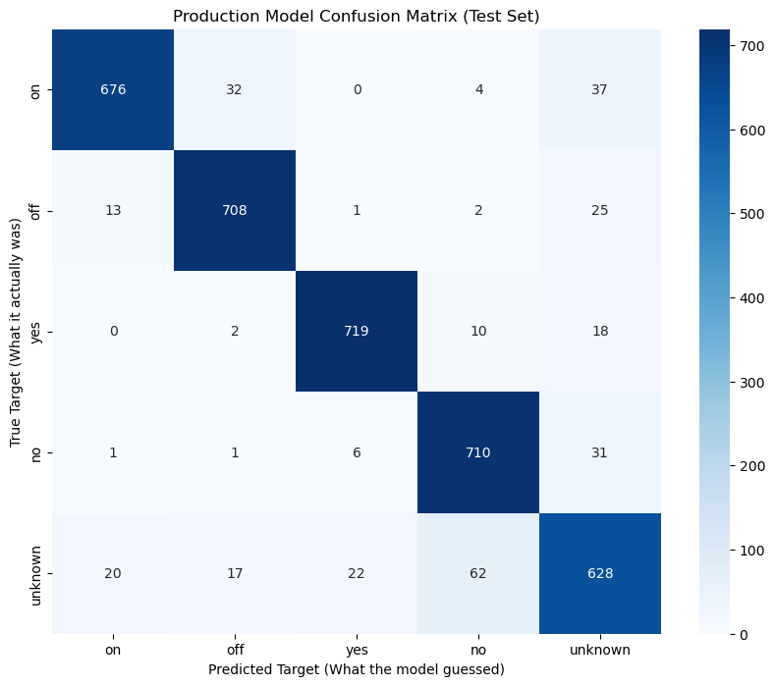

CNN Evaluation
Confusion Matrix
91.24%
Validation Accuracy
>90%
Confidence Gate Threshold

Slide 5

Java Concurrency
01
02
Explicit Thread Pool
Bounded Queue
Dynamically scaled worker threads to process simultaneous incoming audio streams.
Strict capacity limit of 100 requests to protect the JVM from memory exhaustion.
03
04
Active Backpressure
Async Execution
Custom rejection handler intentionally drops overflow traffic to prevent system collapse.
Non-blocking network calls ensure the main microphone listening thread never freezes.

Slide 6
Workload: 5,000 Audio Chunks
Processing: Java Parallel Streams (Multi-Core)
Speedup Factor: 6.05x
02
CPU Benchmark

Slide 7
Additive Increase: Slowly scales up pool size (checking for network stability).
Multiplicative Decrease: Instantly halves pool size when latency spikes above 850ms (protecting the Python ML engine).
Result: A self-regulating system that maintains optimal throughput without manual tuning.
Threshold: Latency > 850ms
Reaction: 50% reduction
03
Dynamic Congestion Control (AIMD)

Slide 8
Resilience & Failure Injection
gRPC Timeout: 1000 ms
1301
Completed Requests
153
Safely Rejected (Backpressure)
46
Failed (Timeouts)
18.1
Throughput

Slide 9


Architecture Decisions
Bounded Queue Strategy
Implemented an explicit ArrayBlockingQueue (Capacity: 100) instead of relying on unbounded memory.
Lockup Protection
ArrayBlockingQueue<Runnable> boundedQueue = new ArrayBlockingQueue<>(100); RejectedExecutionHandler rejectionHandler = (runnable, executor) -> { rejectedWork.incrementAndGet(); System.err.println(“System full! Request rejected."); };
Completely prevents JVM OutOfMemory crashes and stops the Python ML engine from locking up under extreme loads..
Intentional Data Loss
During severe overload, valid user voice commands are explicitly dropped rather than processed slowly.
Designing for Resilience: We intentionally prioritized absolute system stability over attempting to process every single request during an unpredictable traffic burst.
System Observability
Future engineers can trace bottlenecks by monitoring the "Rejected Requests" metric and checking the AIMD logs.

Slide 10

THANK YOU

